Slide 1


Cerulean Shield
OPS 401 FINAL PROJECT PRESENTATION

Slide 2
AGENDA
1
2
3
Team Introductions
Problem Domain & Project Overview
Topologies and Flowcharts
4
5
Demonstrations
Q & A

Slide 3
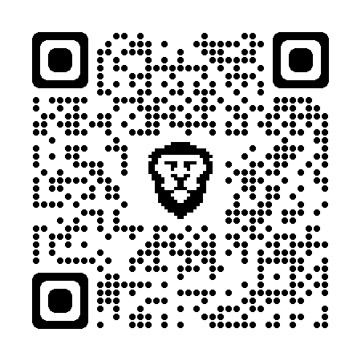
Our Team
GitHub Project Page
Gerald Reitmeyer
Benjamin Hobbs
Robert Gillespie
Jonathan McMullin
Chris Bennett
https://github.com/Cerulean-Shield

Slide 4
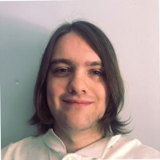
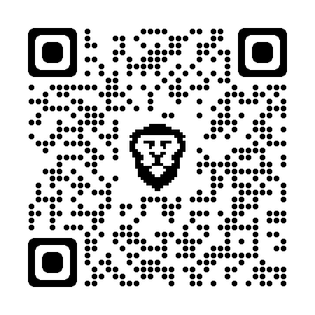
Gerald Reitmeyer
Retail and Landscaping background
Why Cyber?
Privacy
Notes:
More about privacy
What i wanna do
Fields
What gets me excited

Slide 5
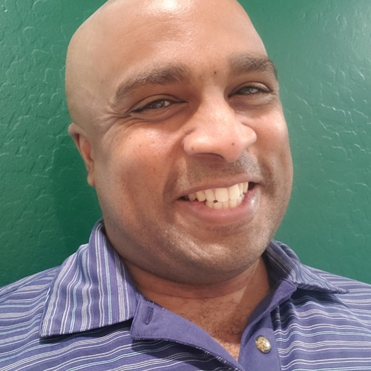

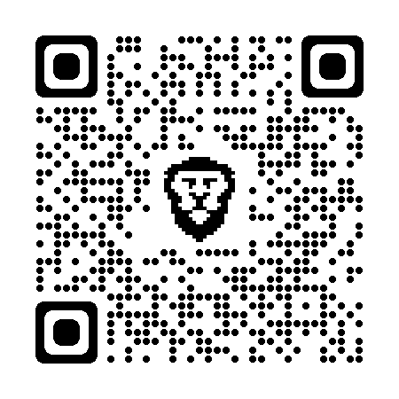
Benjamin Hobbs
Cybersecurity Engineer
Background
Supply Chain/Logistics Management
Real Estate
Why Transition to Cybersecurity?
Experience
Navy, Marine Corps Veteran
M.S. in International Business Leadership
6 continents traveled, 2 continents lived
Notes:
Ben-

Slide 6
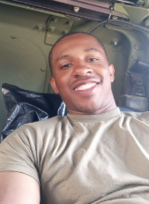
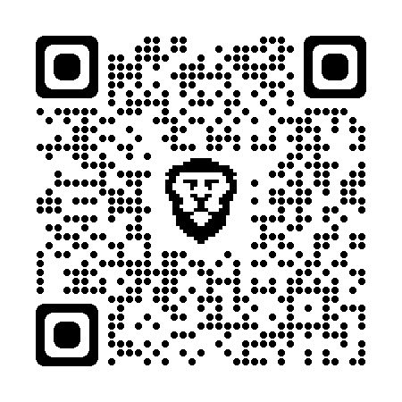
Robert Gillespie
Army National Guard
Active Security Clearance
Background in:
Social Service
Looking for a meaningful and fulfilling career that I can continuously learn

Slide 7
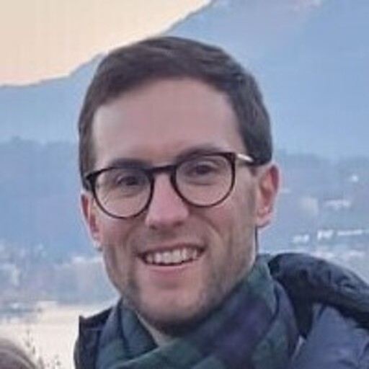
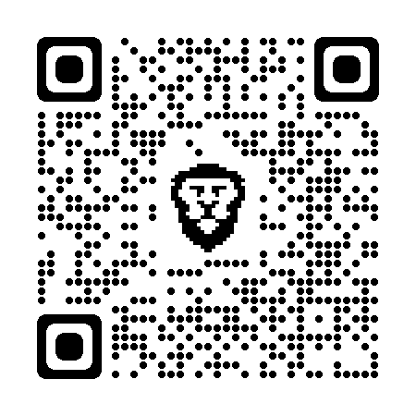
Jonathan Mcmullin
US Army Veteran
Active security clearance - specialized in Human Intelligence
Strong interpersonal and analytical skills
Fluent in English and Russian
Information Security / Cyber Threat Intelligence

Slide 8

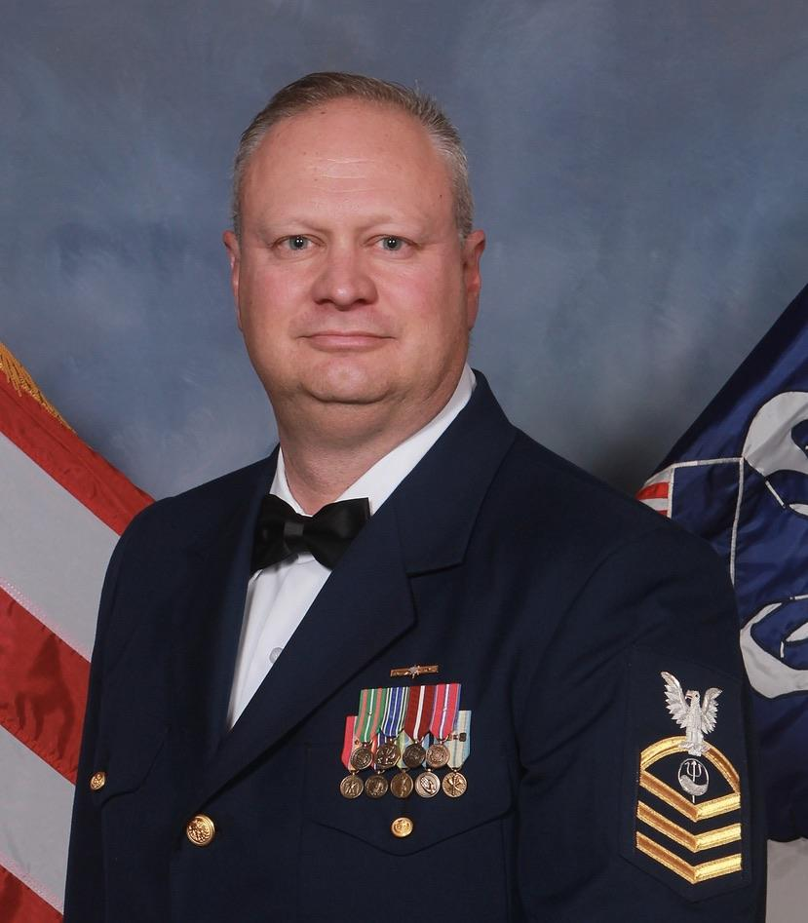

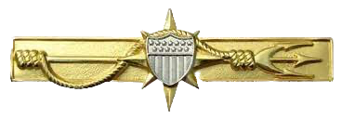
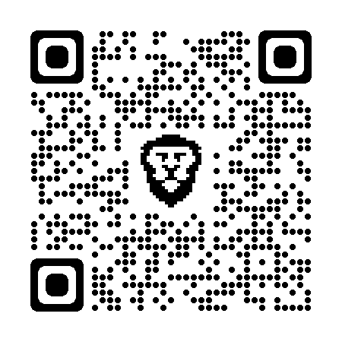
Chris Bennett
Retired Coast Guard Chief Petty Officer
Master of Arts in Homeland Security
Background in:
Physical security management
Regulatory compliance and enforcement
Emergency and crisis management.
Looking to leverage previous background as I expand into cybersecurity

Slide 9
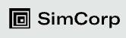

Problem Domain and Scenario
Contracted to perform a one-time adversary emulation engagement for SimCorp
Company had a previous sensitive data exposure
Our team acted as “blue” team
Detection and threat hunting focus, rather than denial and disruption

Slide 10
Solutions
01
Alerts
02
AWS Monitoring Tools
03
NIDS
04
Investigation Tools
Established real-time alerts for certain activities such as brute force attempts
CloudTrail, CloudWatch, GuardDuty and AWS Detective
Network Intrusion Detection with Snort
Splunk, Sysmon Logs
Notes:
Jon

Slide 11
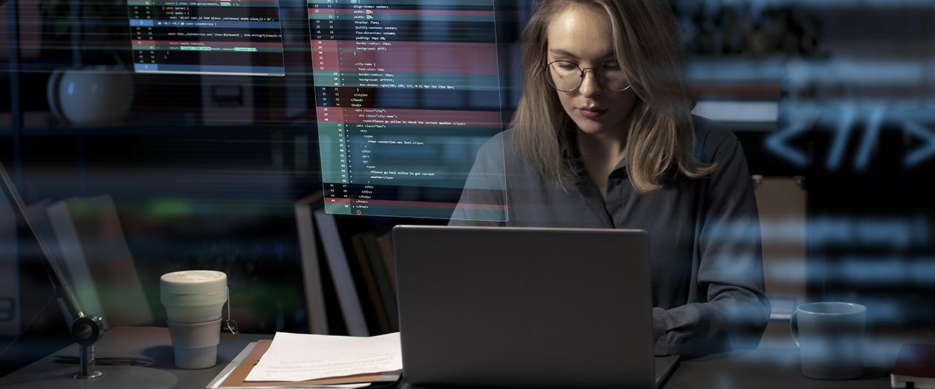
Topologies and Flowcharts

Slide 12
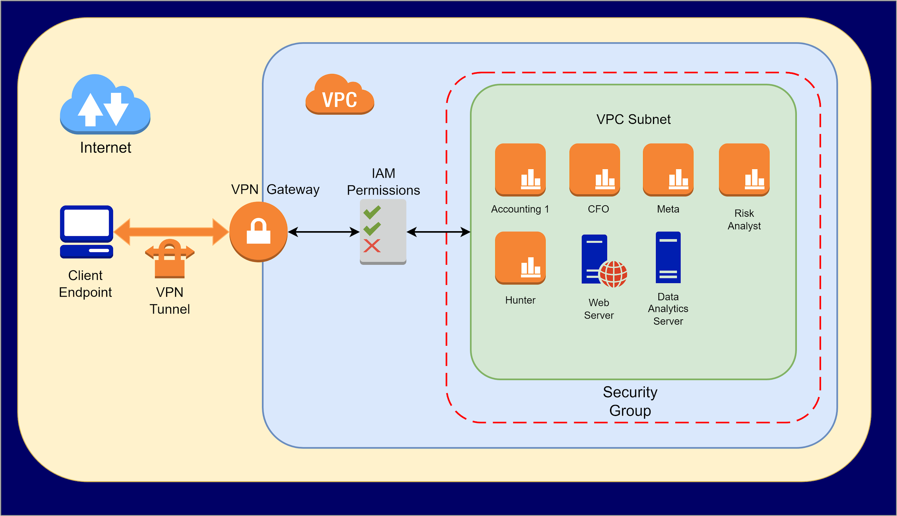
System Topology
Notes:
JOn

Slide 13
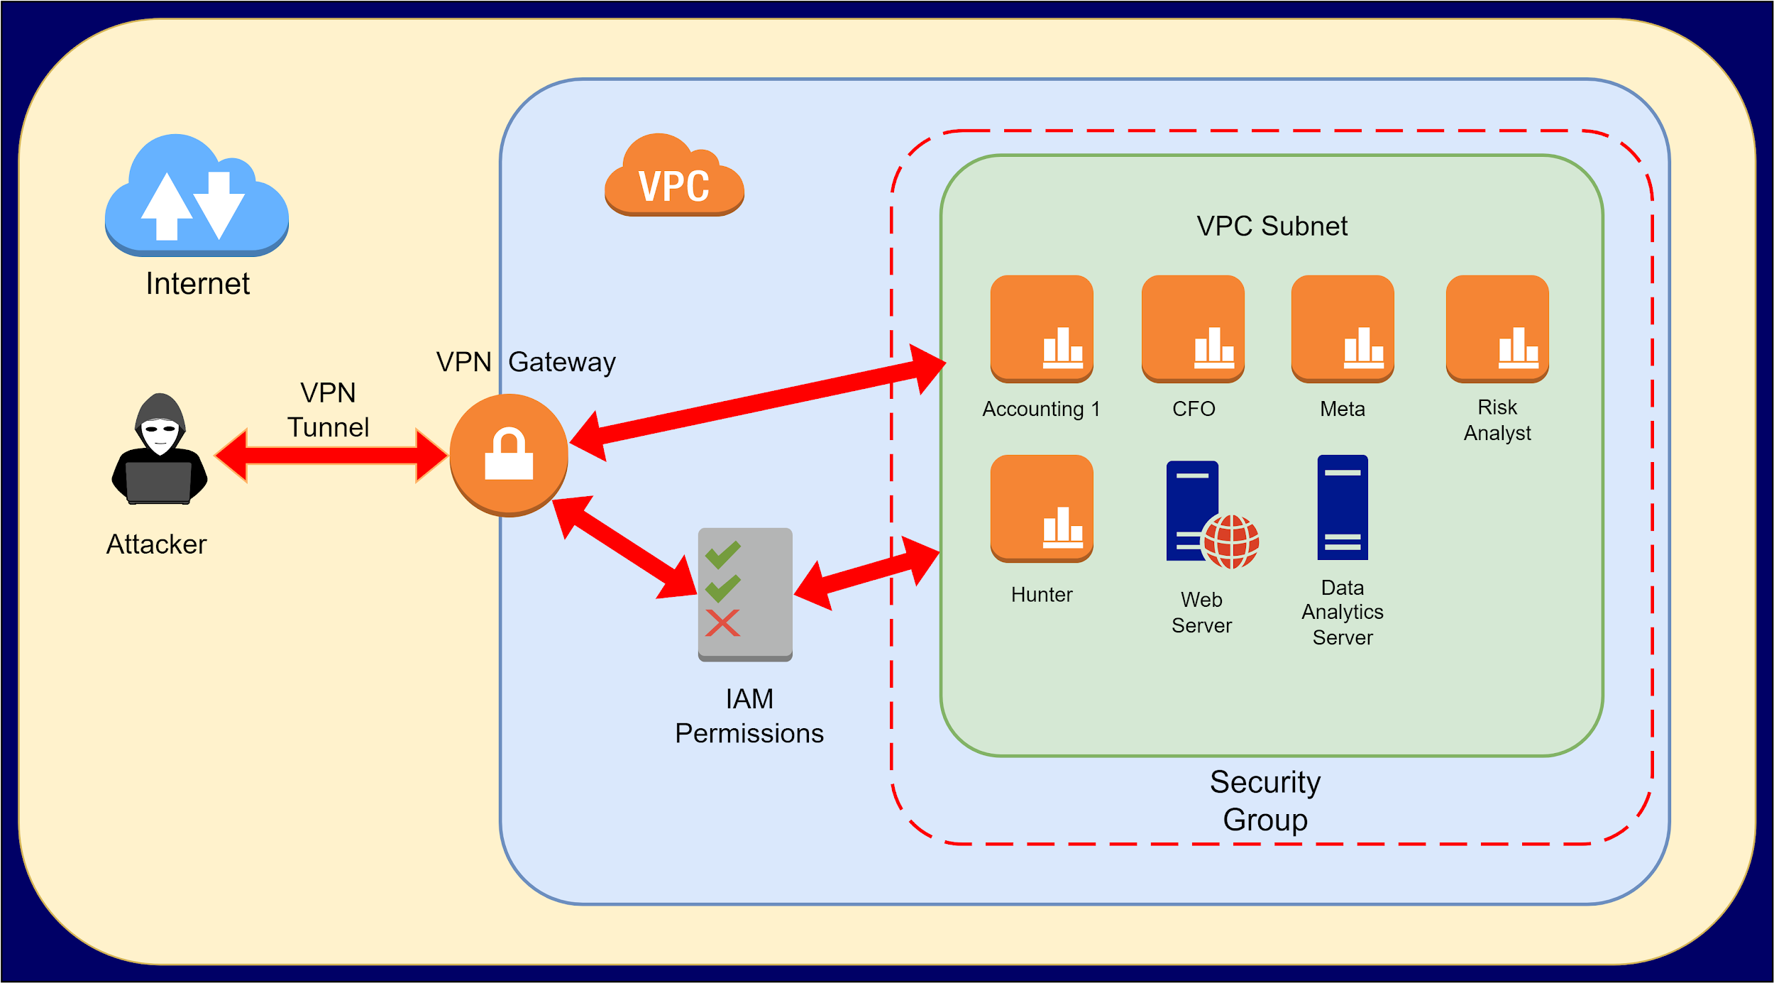
Possible Attack Vectors
STRIDE
Notes:
Jon

Slide 14
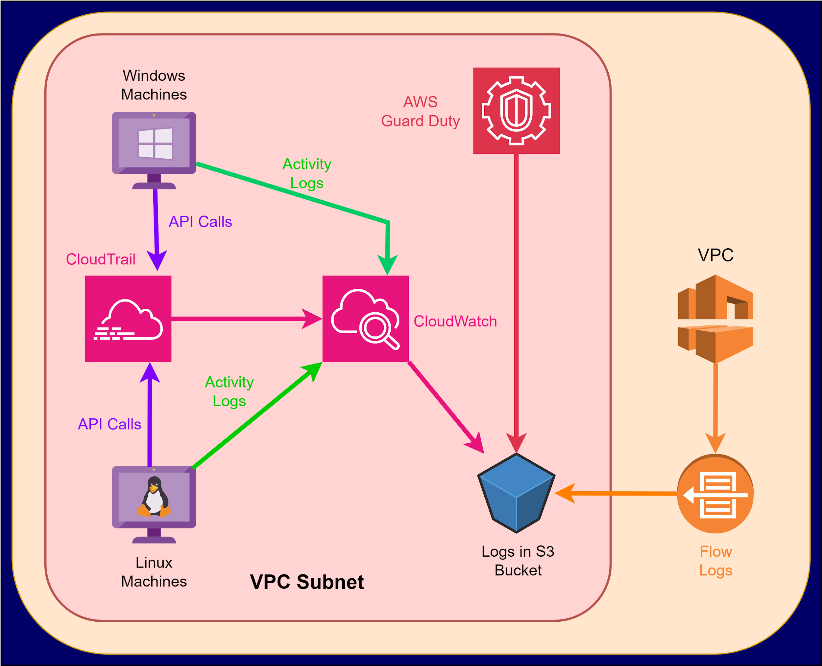
AWS Monitoring
Notes:
Chris

Slide 15
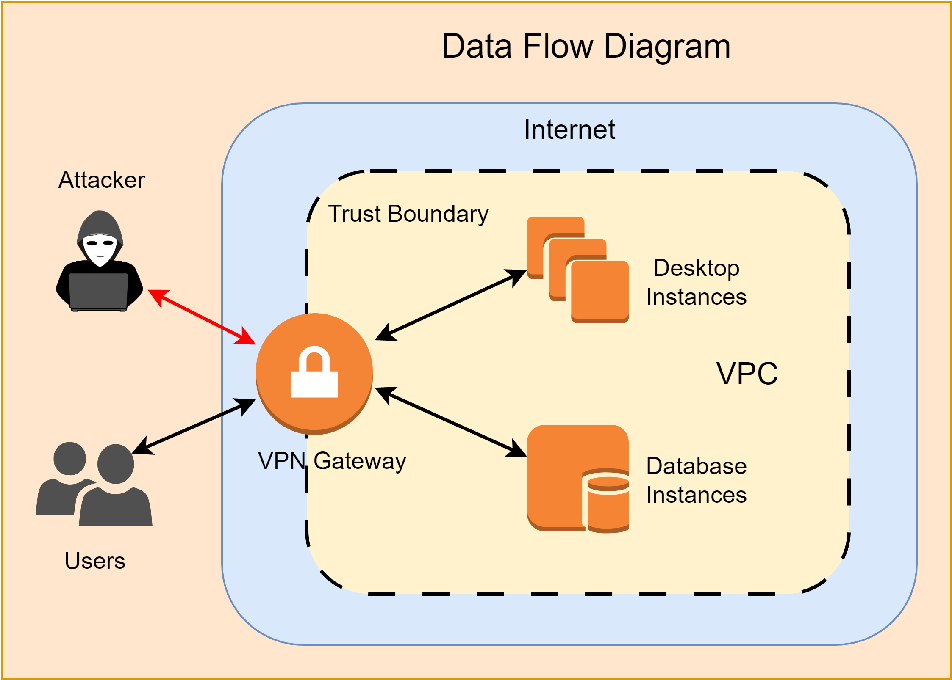
Data Flow Diagram
Notes:
Chris

Slide 16
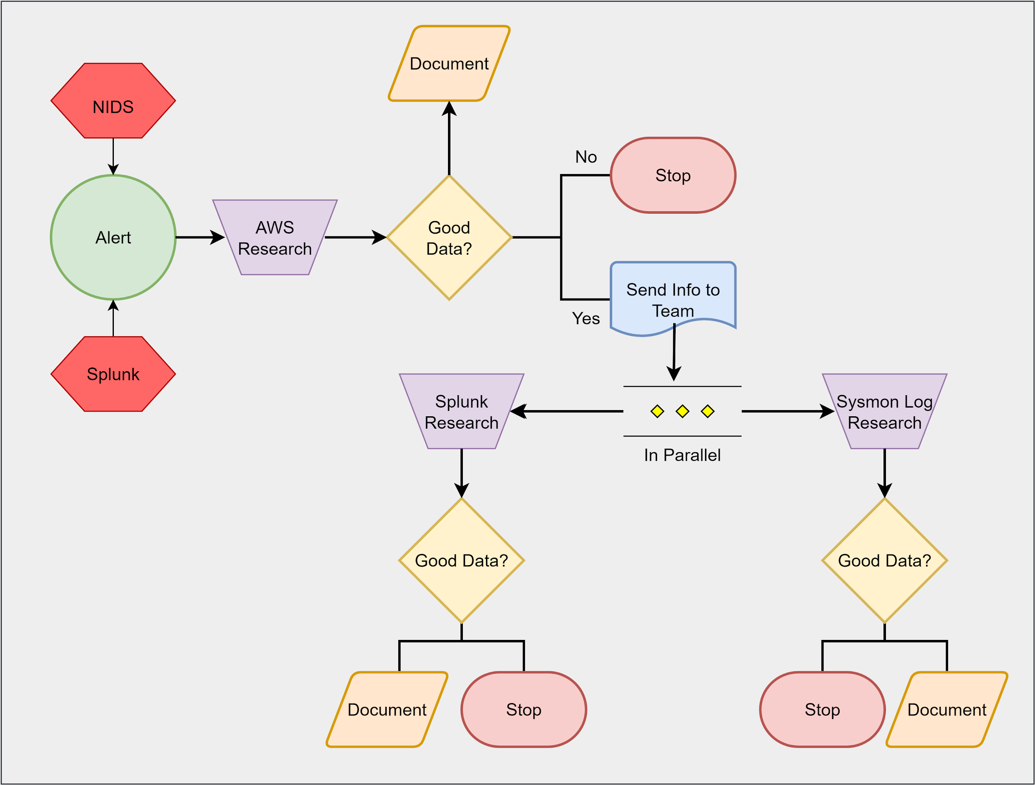
Process Flowchart
Notes:
Chris

Slide 17

Demonstrations
Notes:
Jon

Slide 18
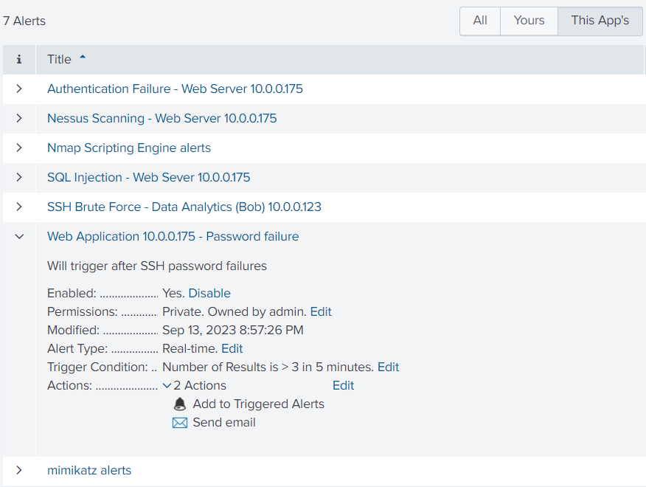
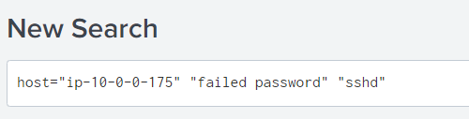

Alert Generation - Splunk
Notes:
Jon

Slide 19
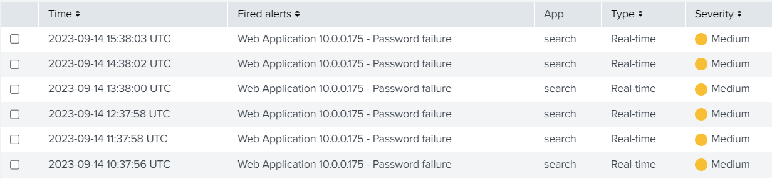
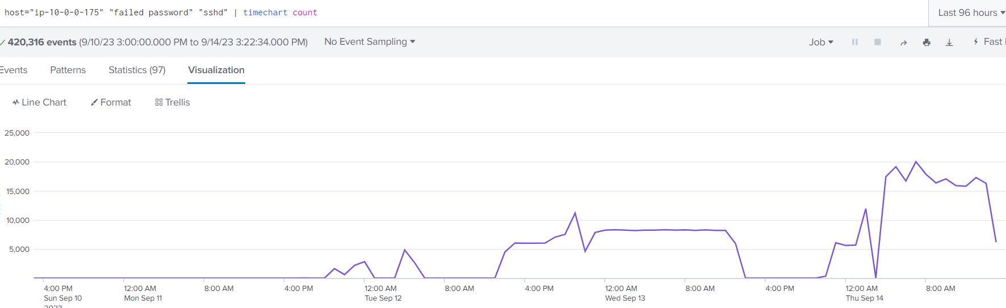
Notes:
Jon

Slide 20
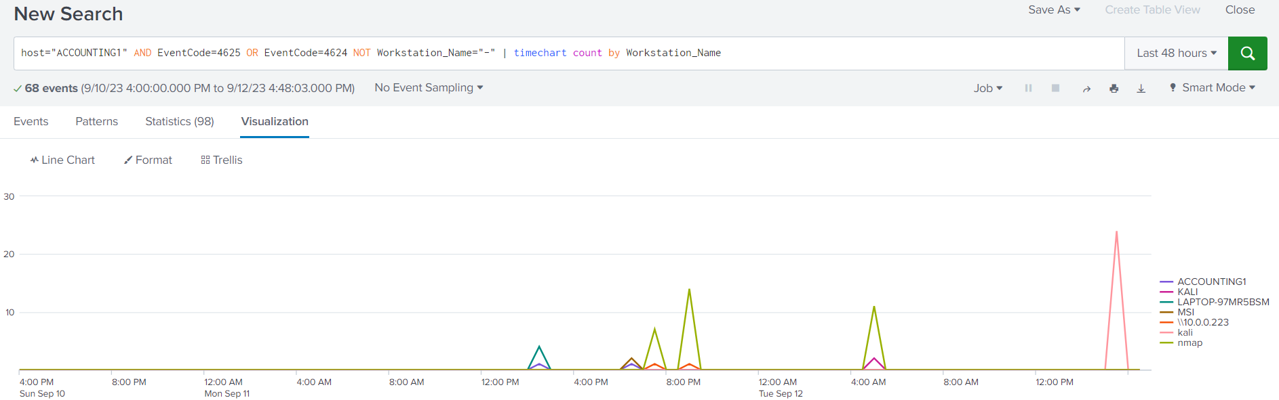

Slide 21
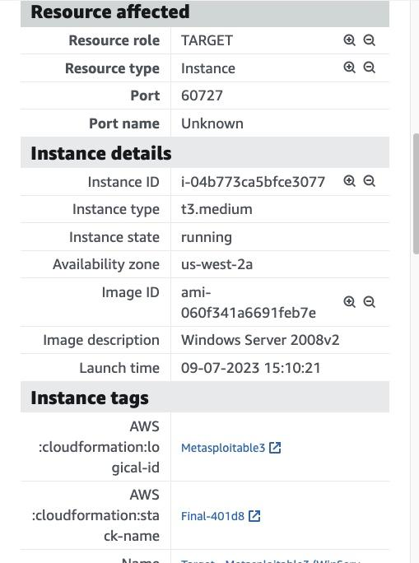
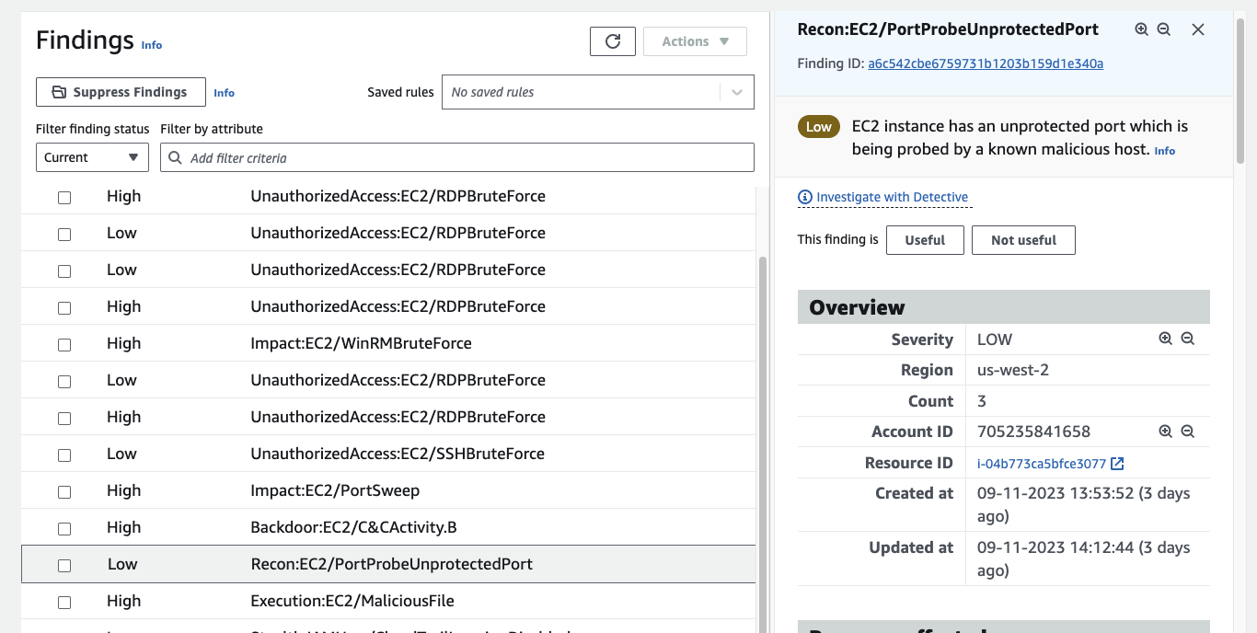
Port Probe
Notes:
Chris

Slide 22
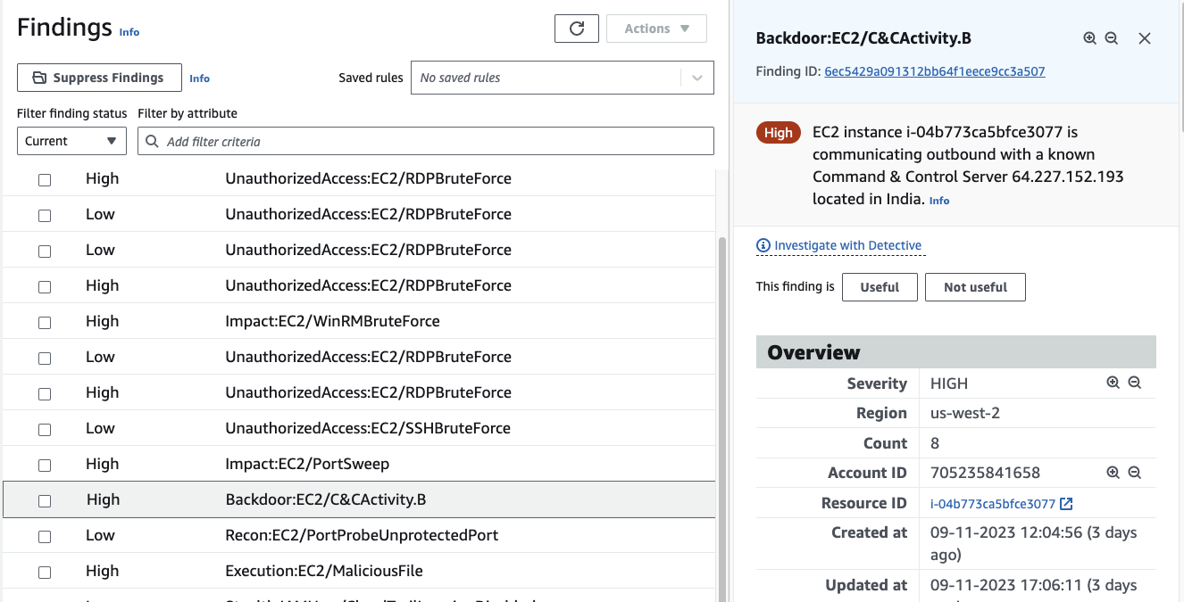
Command and Control (C2)

Slide 23
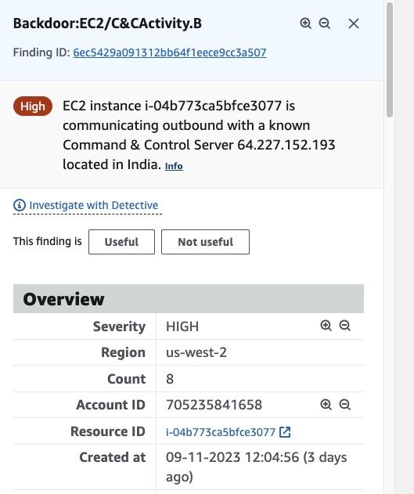
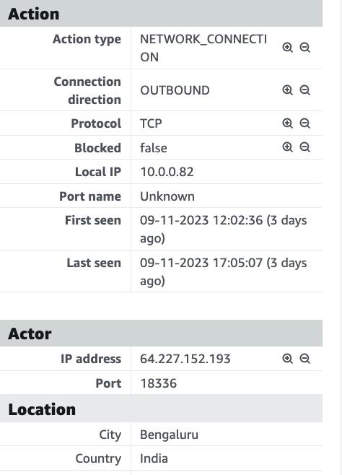
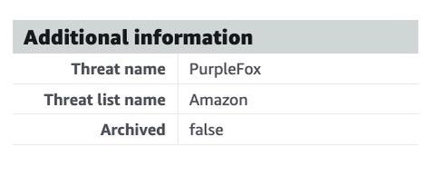
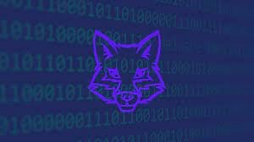
Command and Control (C2)
Establishing a Backdoor
Threat Actor
Campaign Identified

Slide 24
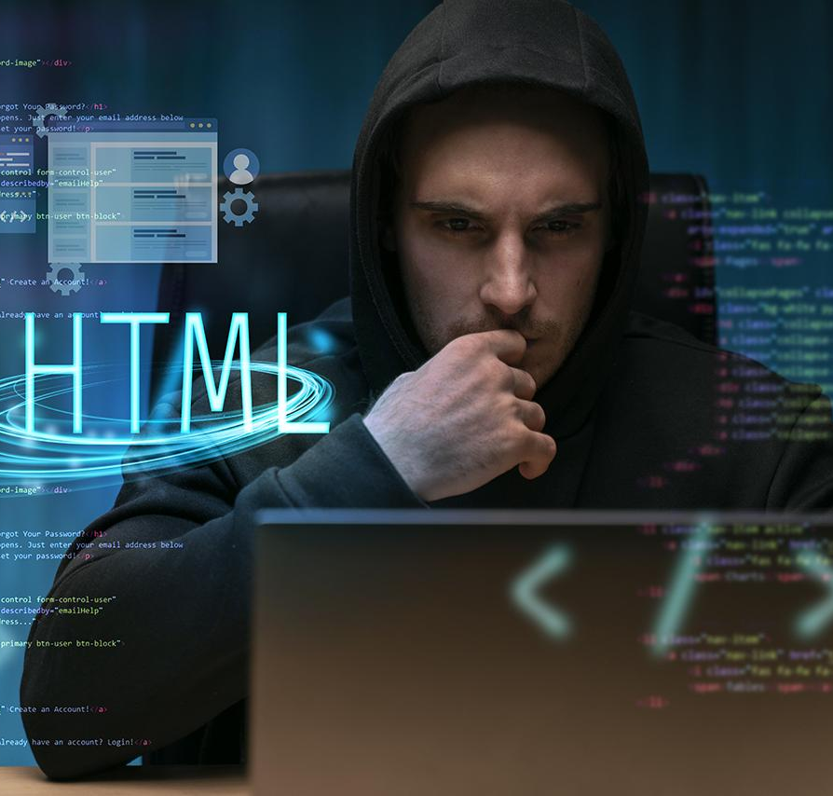
Purple Fox
Key MITRE TTPs for Purple Fox:
T1071.001 - Application Layer Protocol: Web Protocols
T1543.003 - Create or Modify System Process: Windows Service
T1059 - Command and Scripting Interpreter
T1068 - Exploitation of Privilege Escalation
T1014 - Rootkit
T0849 - Masquerading

Slide 25
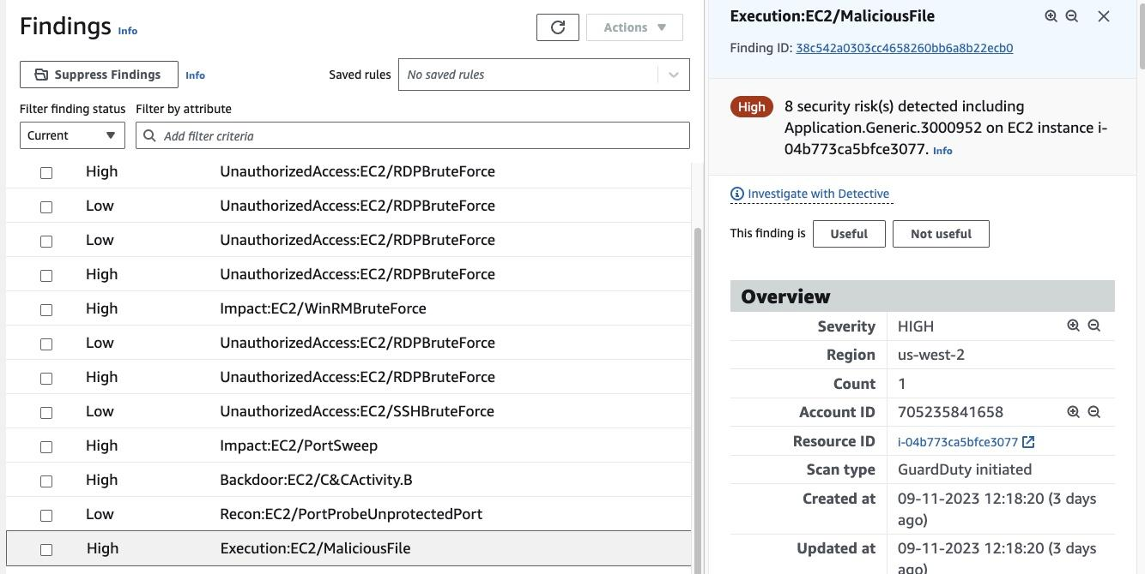
Malicious Files Added

Slide 26
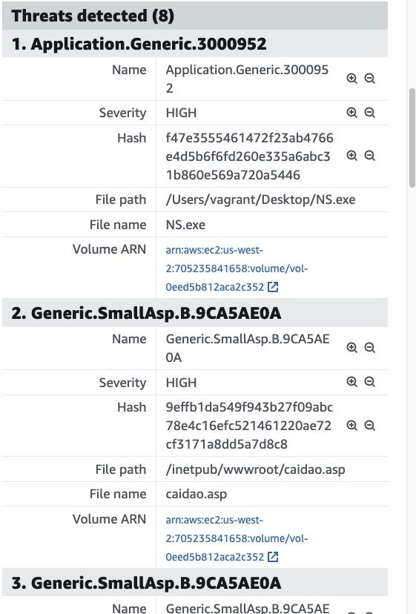
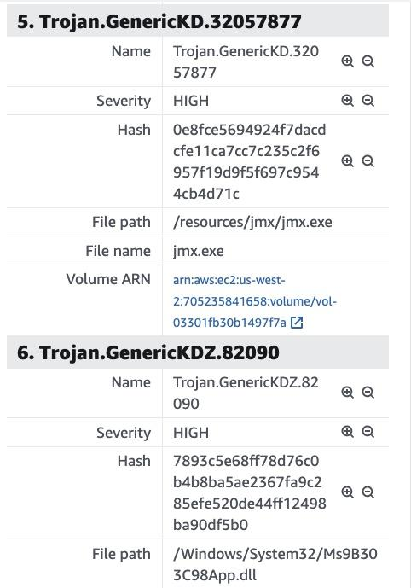
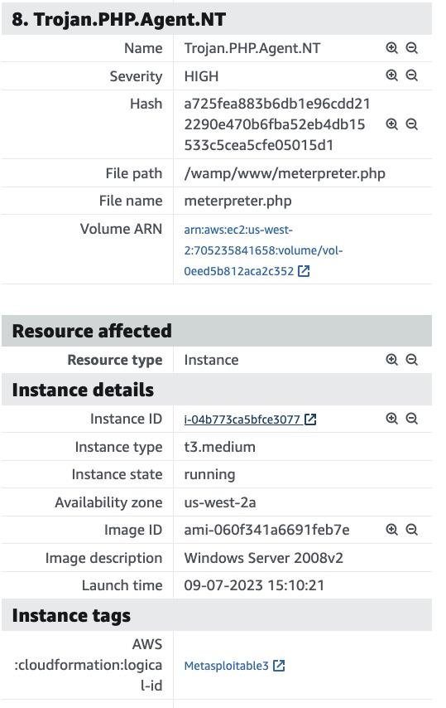
Malicious Files Added
Spyware and Backdoor
Installing Trojans
Meterpreter Payload
Program Name
Hash
File Path and Name
Notes:
Chris

Slide 27
Sysmon
Sysmon is a Windows utility developed by Microsoft.
It monitors and records various system activities and security-related events.
It helps enhance system security, detect threats, and assist in system troubleshooting and incident response.

Slide 28
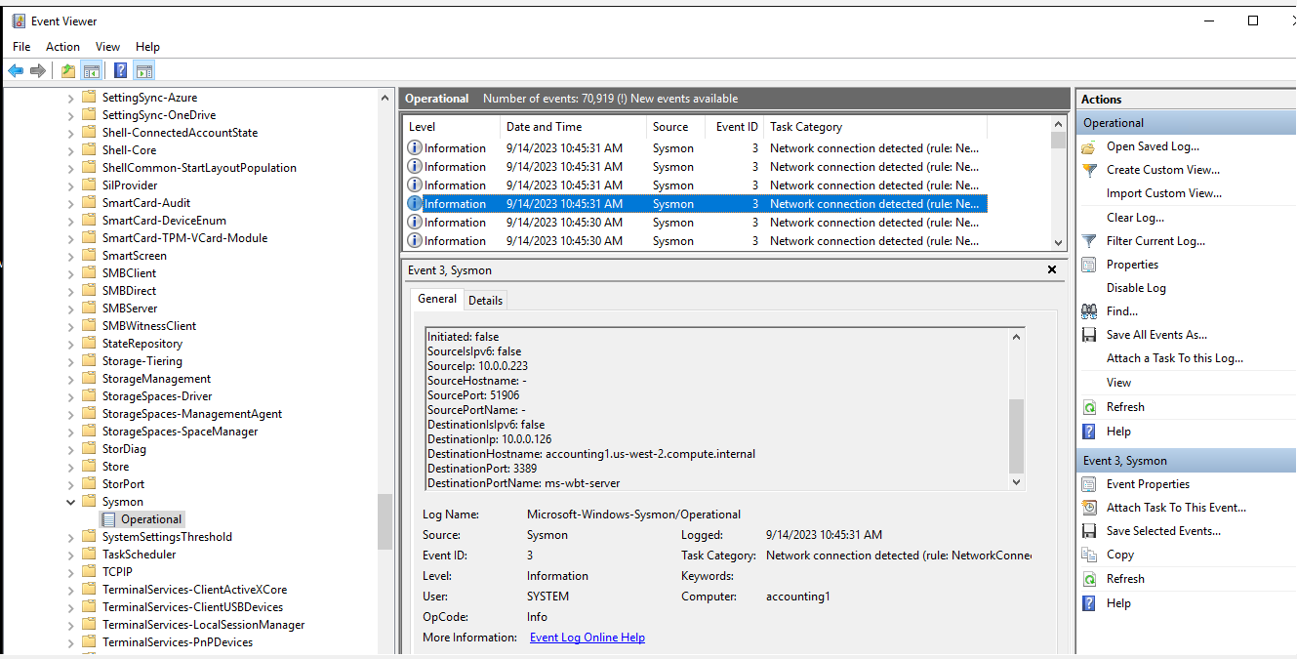
Sysmon(Unauthorized Users)

Slide 29
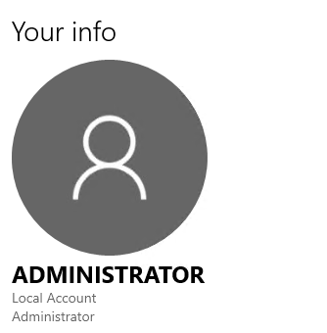
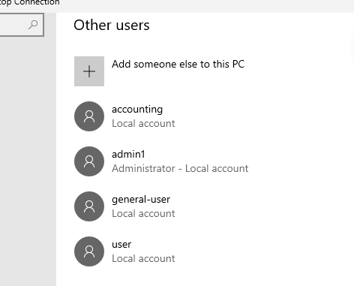
Sysmon(Unauthorized Users)

Slide 30
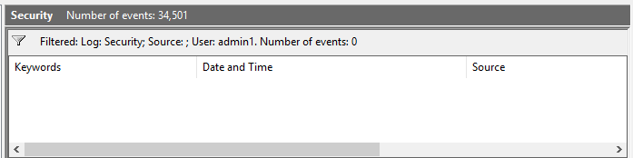
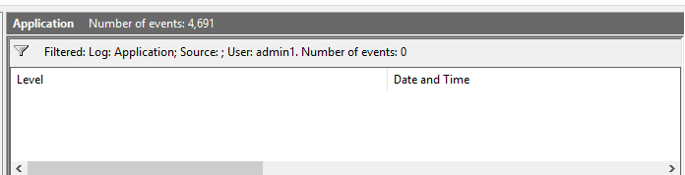
Sysmon(Deleted Logs)
Notes:
Rob

Slide 31
Sysmon(Deleted Logs)
Notes:
Rob

Slide 32
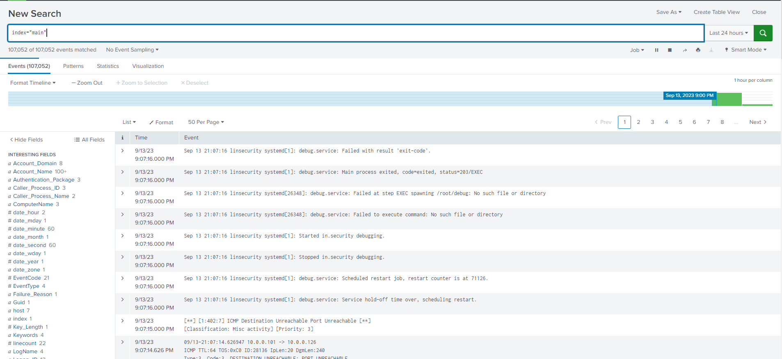
Splunk Logs
This is the data without any filters
Notes:
Gerald

Slide 33
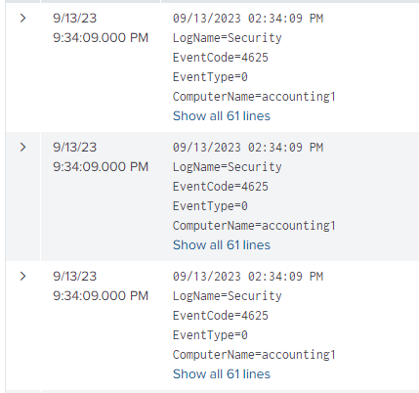
Splunk Logs
Filter out not helpful logs
Context of what we are looking for

Slide 34
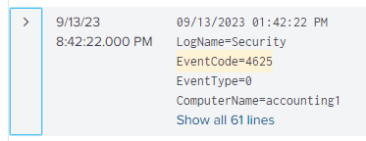
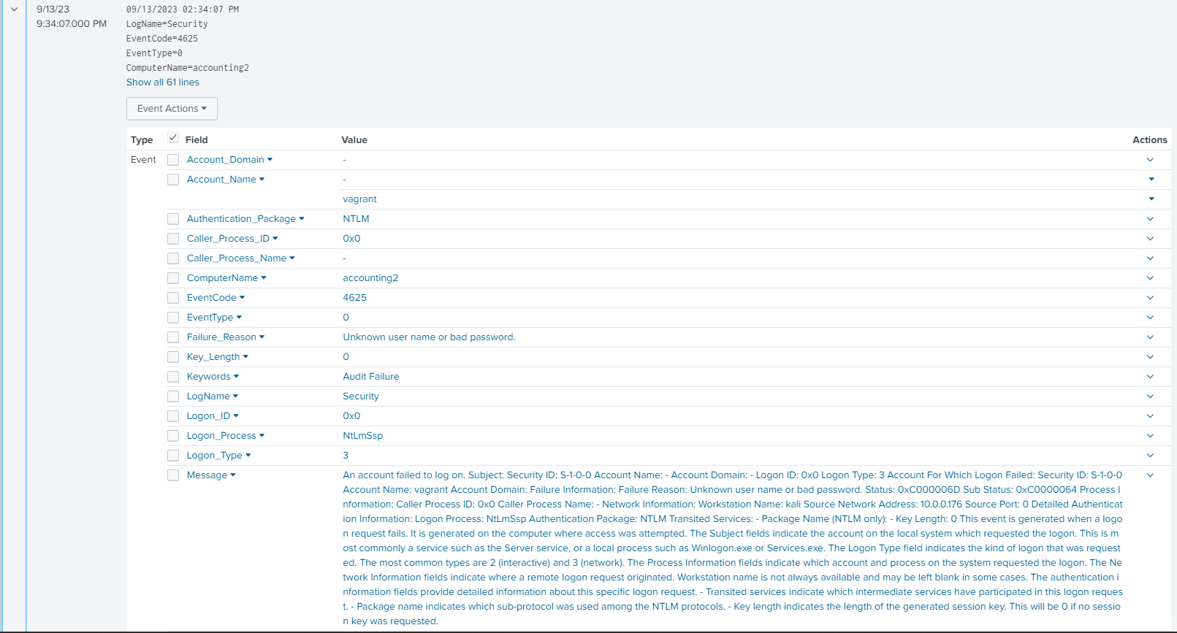
Splunk Logs
Recurring event code
LogName=Security
SSH as user Vagrant
Failed password attempts
Notes:
Vagrant shows lateral movement

Slide 35
Results
-Indicators of Compromise
Files
Hashes
User Accounts
Log Outputs
Log Books, Cameras, etc.
-Compilation and Threat Intel Research
-Document our Findings in a report
-Handoff to DFIR
-Refine Alerts for future monitoring
Notes:
Ben

Slide 36
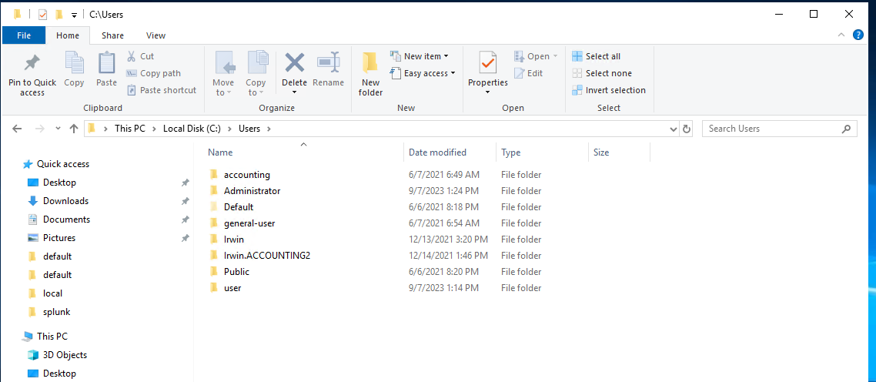
Results
Notes:
Ben

Slide 37
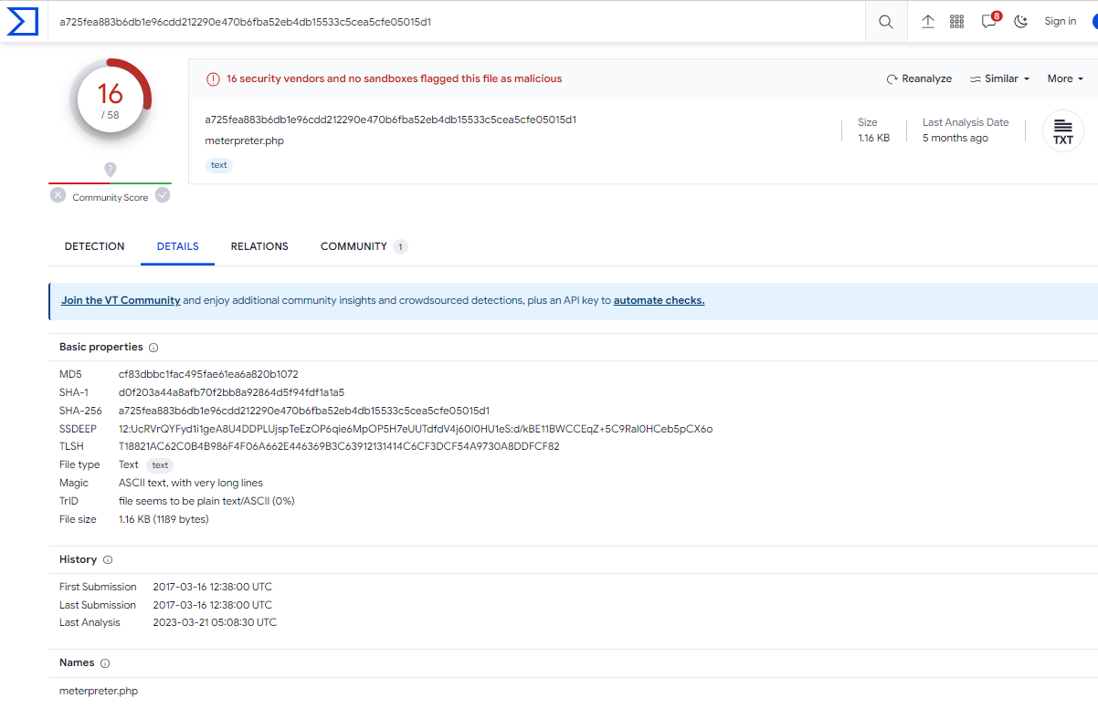
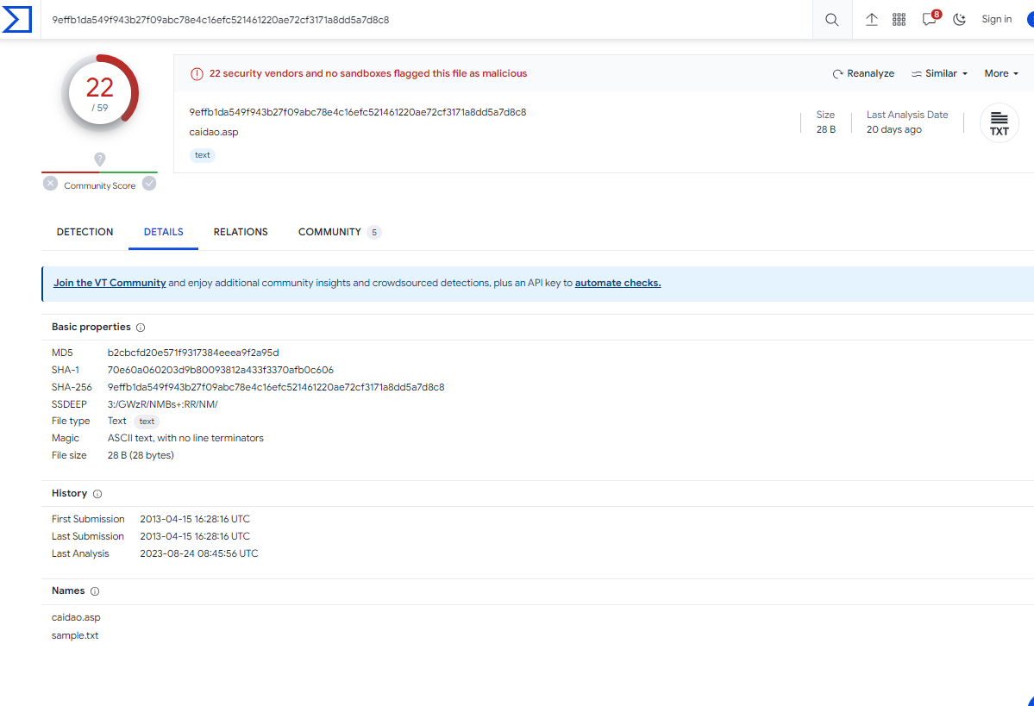
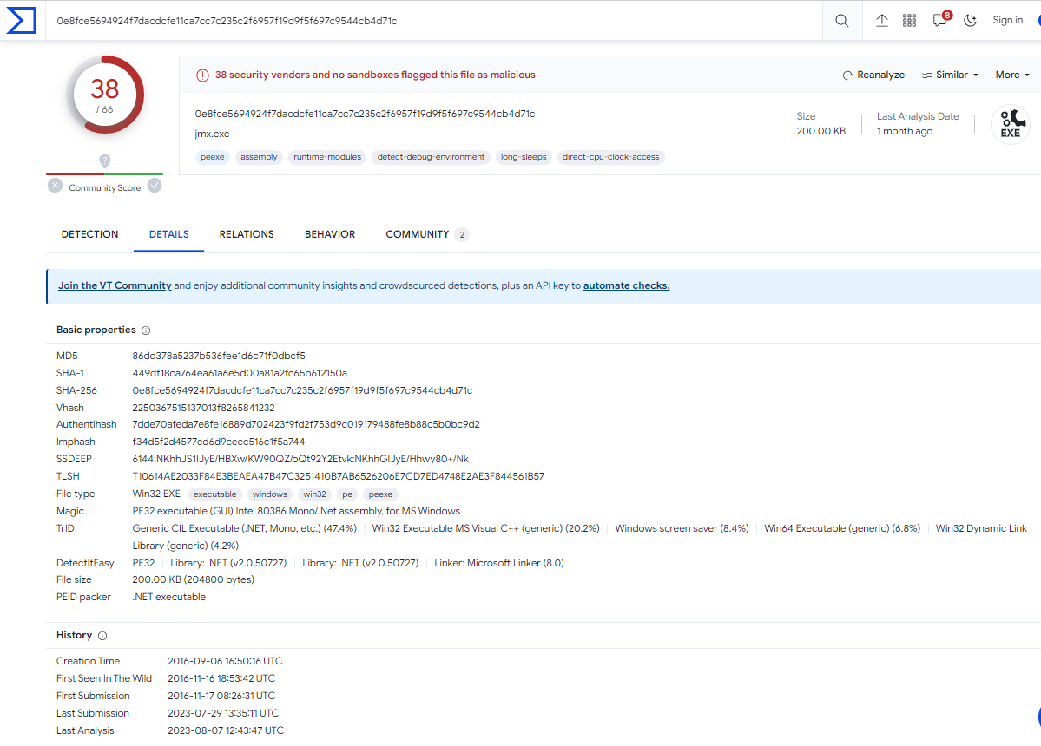
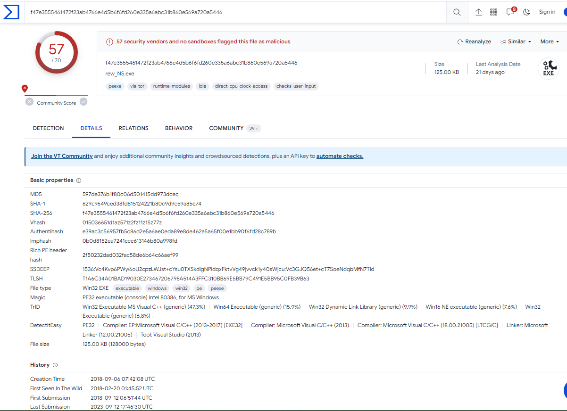
Results
Notes:
Ben

Slide 38
Thanks!
We would like to thank:
Our instructors: Marco, Ethan and Alex
Our families and loved ones
Our Teammates and classmates
Everyone else who tuned in to watch our presentation today
Notes:
Ben

Slide 39
QUESTIONS?

Slide 40

THE NIKON SPIDER
$100,000 REWARD
FOR HACKING AND GENERALLY UNSAVORY BEHAVIOR
Notes:
Ben

